Slide 1
IEC 61400-15 WG Update
Assessment of Wind Resource, Energy Yield, and Site Suitability Input Conditions for Wind Power Plants
Jason Fields, Secretary

Slide 2
IEC 61400-15
CD Expected to be issued late 2017/early 2018
Intended to compliment other IEC standards
  61400-1 (Design)
  61400-12 (Power Performance Testing)
Committee has 55 members (2nd largest wind standard)
Next Meeting: Porto, Portugal June 2017
Broad Engagement
  OEM’s
  Owner/Operators
  Consultancies
  Research Institutes

Slide 3
Foundational Work
Existing related standards & best practices
Other documents/collaborations
IEC 61400-1,3 Wind Turbine: Design Requirements
IEC 61400-12-1 Power Performance Testing
IEC 61400-26 Availability: Technical Specification
MEASNET “Evaluation of site specific winds”
Consortium Loss & Uncertainty definitions
Wind Resource Assessment: A Practical Guide to Developing a Wind Project
IEA Wind Task 32 Remote Sensing
IEA Wind Task 31 Windbench and Wakebench
IEA Task 11 75th meeting on complex terrain
Power Curve Working Group

Slide 4
Goals – Normative (Required)
Define standards for reporting
  A checklist of items that must be considered in an assessment
  Report must cover the checklist and explain how each item was considered
  Example: Wind speed predictions at turbine locations
Define IEC uncertainty model
  Explicit calculation of uncertainty
  Provides benchmark for readers
  Organizations can still use their own uncertainty calculation but would need to also report the IEC calculation and explain differences
  Used as a tool to show what activities can reduce uncertainty
    Met towers
    High quality anemometers
Define turbine suitability load calculation inputs
  Each manufacturer asks for different datasets to run their loads model
  Standardize the data to improve quality and transparency

Slide 5
Goals – informative (Recommended)
Provide industry consensus best practices, including multiple approaches to common problems
  Measurement (Local Site Conditions)
    Measurement strategy
    Measurement parameters
    Measurement Devices
      Meteorological Towers and Instrumentation
      Remote Sensing
    Data Management
    Production data from nearby projects
    Alternative valid measurements
  Data Analysis
    Traceability and Calibration
    Quality control of data
  Wind Resource Modeling
    Gap Filling
    Long-Term
    Vertical Extrapolation
    Horizontal Extrapolation
    Validation (all of the above)
  Wind Plant Energy Yield Modeling
    Ideal Energy Yield
    Wake
    Losses
  Statistical description of measurements
    Frequency Distributions
    Wind Roses
    8760

Slide 6
Current status
Loss factor reporting tables ready for external review.
Uncertainty reporting categories ready for external review
Uncertainty calculation methods in progress
Document components being aggregated now for CD
Document available that outlines all this in detail – contact your local shadow committee, or me (jason.fields@nrel.gov), for a copy

Slide 7
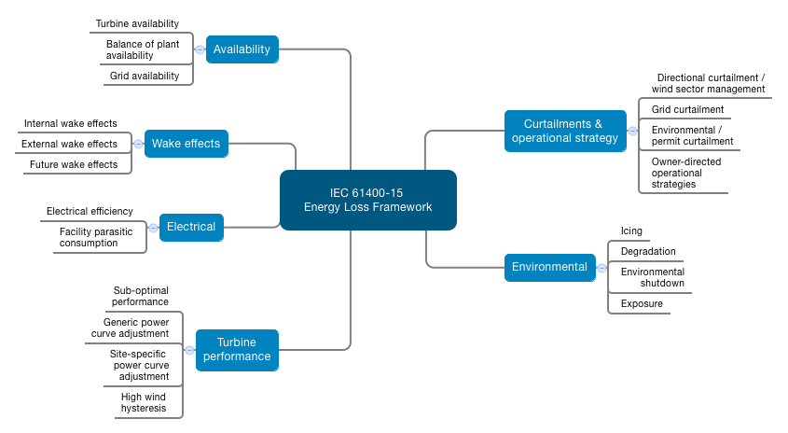
Loss Framework

Slide 8
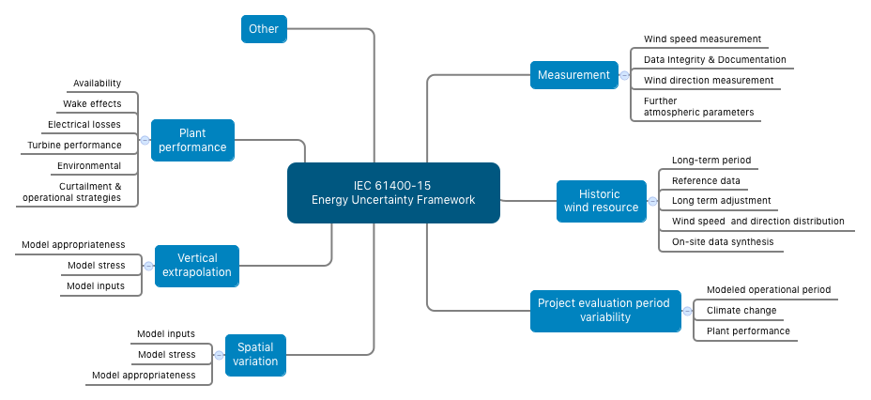
Uncertainty Framework

Slide 9

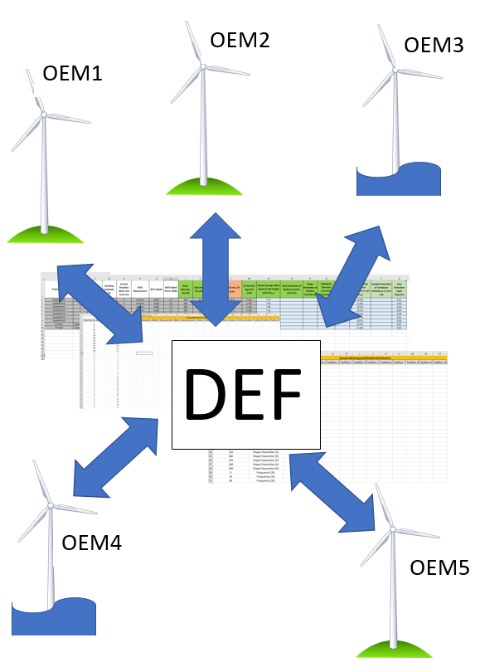
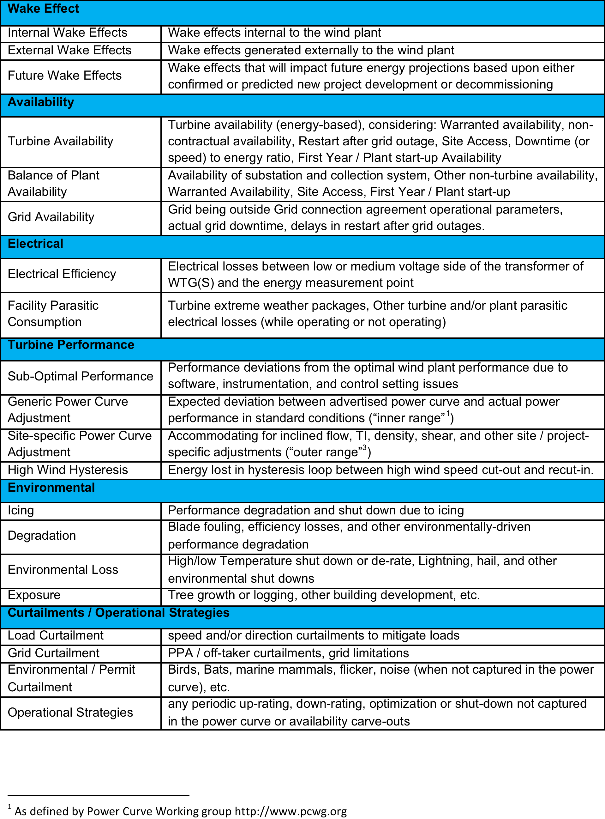
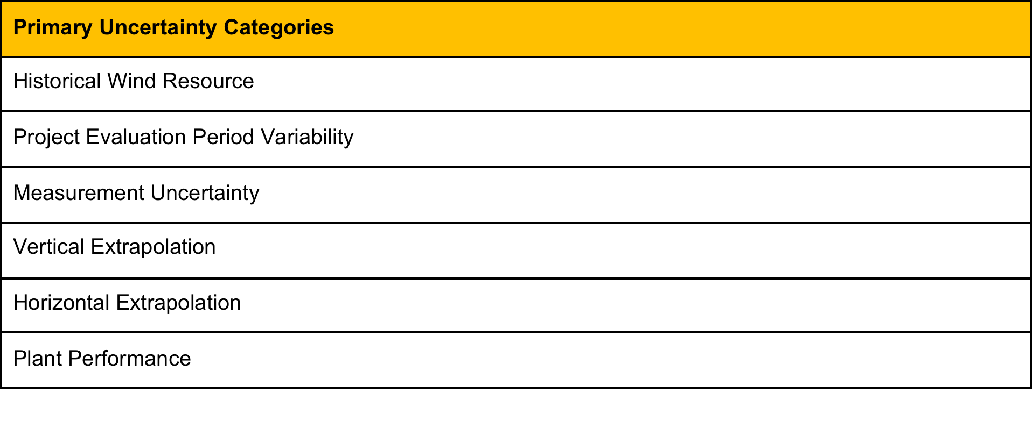
Formal update document

Slide 10
Collaboration Ideas
PCWG:
Define best practice
Test existing & new methods

Slide 11
Appendix

Slide 12
Scope of Standard - Approved
The scope of this standard is to define a framework for assessment and reporting of the wind resource, energy yield and site suitability input conditions for both onshore and offshore wind power plants. This includes:
1. Definition, measurement, and prediction of the long-term meteorological and wind flow characteristics at the site
2. Integration of the long-term meteorological and wind flow characteristics with wind turbine and balance of plant characteristics to predict net energy yield
3. Characterizing environmental extremes and other relevant plant design drivers
4. Assessing the uncertainty associated with each of these steps
5. Addressing documentation and reporting requirements to help ensure the traceability of the assessment processes
The framework will be defined such that applicable national norms are considered and industry best practices are utilized.
The meteorological and wind flow characteristics addressed in this document relate to wind conditions, where parameters such as wind speed, wind direction, air density or air temperature are included to the extent that they affect the operation and structural integrity of a wind turbine (WTGS) and energy production analysis.
According to IEC 61400-1 and 61400-3 the site specific conditions can be broken down into wind conditions, other environmental conditions, soil conditions, ocean/lake conditions and electrical conditions. All of these site conditions other than site specific wind conditions and related documents are out of scope for this standard.
This standard is framed to complement and support the scope of related IEC 61400 series standards by defining environmental input conditions. It is not intended to supersede the design and suitability requirements presented in those standards. Specific analytical and modeling procedures as described in IEC 61400-1, 61400-2, and 61400-3 are excluded from this scope.

Slide 13
Scope of standard, Pt 2 (for document)
The basic and fundamental goal is to present consensus methodologies on site assessment and to create a set of standard reporting requirements which detail the measurement campaign, analysis processes, and considerations taken by the author of a wind resource characterization and energy yield assessment. The methodologies presented provide a framework to ensure a high quality set of project data are collected and analyzed to support wind resource and site characterization. The standardized reporting process will provide a discrete list of criteria which must be considered and reported on for all projects. These reporting procedures will provide transparency to report readers about the considerations taken during the analysis, and confidence that the analysis considered all of the key criteria and procedures identified by IEC 61400-15 for wind resource assessment.
At a minimum, the document will prescribe standard reporting elements and considerations during the analysis process, and recommend practices to reduce uncertainty for all elements of the assessment and campaign.
Two additional goals of the standard which should be explored by the committee:
Develop a standard uncertainty calculation to be used for benchmarking
Provide standardized inputs for turbine loads calculations
The document will not:
Qualify or disqualify projects
Qualify or disqualify consultants/Independent Engineers

